Slide 1
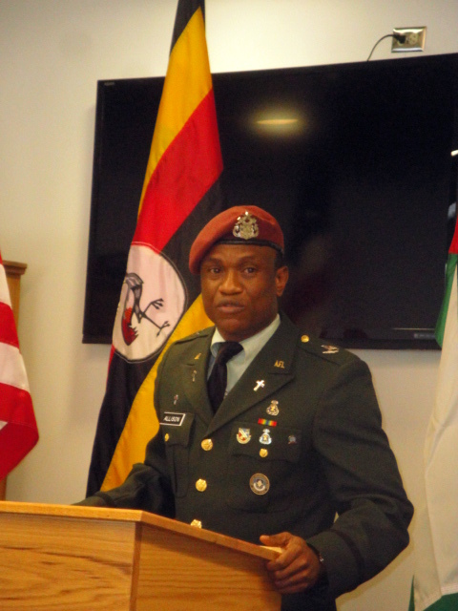
Rationale
for a
Chaplaincy

Slide 2

International Association of Evangelical Chaplains
Vision:
To bring the Gospel of Jesus Christ to every man and woman of the uniformed forces of every nation of the world.

Slide 3
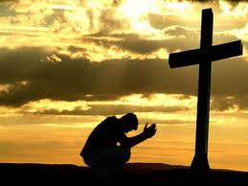
IAEC Mission
To encourage, equip, and empower chaplaincies, chaplains, and individuals involved in evangelical ministry to Uniformed Services worldwide.

Slide 4
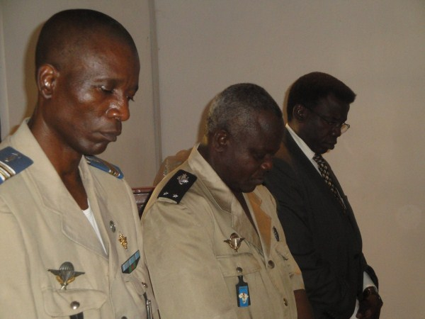
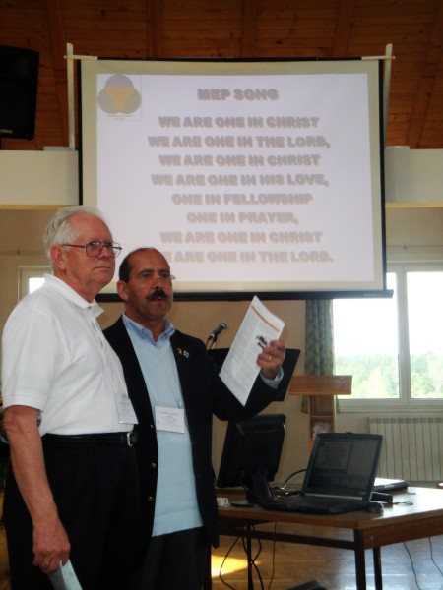
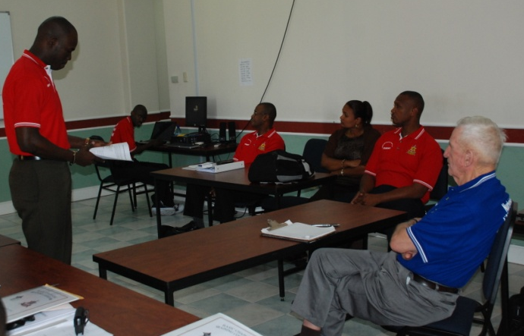
IAEC Goal
To assist in the establishment and development of a government- recognized chaplaincy that includes evangelical Christians.

Slide 5
Uniformed Chaplaincy:
Everyone Benefits
Churches have an avenue to reach out to the military for prayer, evangelism and discipleship.
Military members have their spiritual needs met.
Families are strengthened.
Commanders can rely on soldiers because soldiers can focus on the jobs rather than their problems.
The Military is strengthened as commanders accomplish their mission.

Slide 6
Military Ministry is Biblical
John the Baptist
  Luke 3 – When asked by them, John told soldiers not to extort money, make false accusations, and to be content with their wages
Jesus
  Luke 7 – Jesus heals a Centurion’s servant
Apostles
  Acts 10 – First outpouring of Holy Spirit after Pentecost was on a military family (Cornelius)

Slide 7
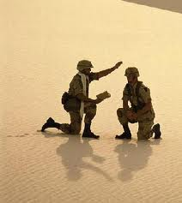
What is a Chaplain?
A clergyman sent by his church
to be a member of the
military.
Serves on a commander’s
staff.
Goes where soldiers go.

Slide 8
Benefits of a Chaplaincy
Chaplains meet the spiritual needs of soldiers.
Chaplains contribute to the overall well-being of the unit.
Chaplains serve as advisors to the commander.
Chaplains strengthen the spiritual and moral foundation of a country.

Slide 9
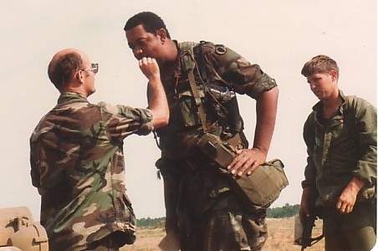
Chaplains Meet the Spiritual
Needs of Soldiers
Primary purpose
Garrison and in the field
On deployments in & out of the country
Care for Casualties
Before, during, and after deployments

Slide 10
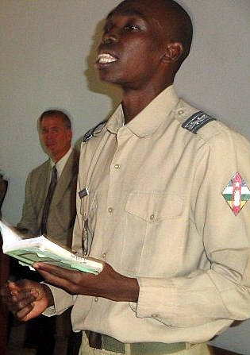
Chaplains Meet the Spiritual
Needs of Soldiers
Worship, Bible studies, discipleship, fellowship
Baptism and communion
Visitation
Pastoral Counseling
Ministry of Presence

Slide 11
Chaplains Add to the Overall Health of the Unit
Address Problems that Negatively Impact the Unit
PROBLEM
No access to worship
Deal with stress in unhealthy ways
Increase in suicides
Family problems and divorce
CHAPLAIN MINISTRY
Chaplains provide worship
Counseling; Stress Management Classes
Counseling; Suicide Awareness Classes
Counseling; Retreats; Workshops

Slide 12
Chaplains Add to the Overall Health of the Unit
Address Problems that Negatively Impact the Unit
PROBLEM
Personal problems
Dealing with death of comrade or family
Morale problems
CHAPLAIN MINISTRY
Worship, Bible studies, counseling, etc.
Serve on Notification team, Memorial Services, grief counseling
Advise commander

Slide 13
Chaplains Add to the Overall Health of the Unit
Address Problems that Negatively Impact the Unit
PROBLEM
Immorality
CHAPLAIN MINISTRY
Preaching, teaching, Bible studies
Teach classes: Moral Leadership, Integrity, Honesty, Building a Strong Family, Loyalty, Duty, Responsibility, Selfless Service
When Soldiers are right with God and at peace with others they can focus on their jobs rather their problems!

Slide 14
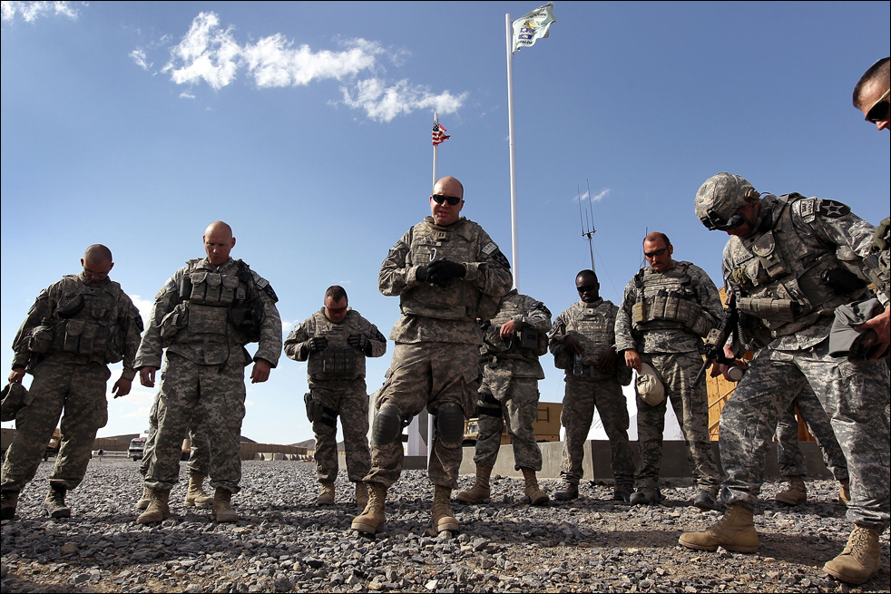
Chaplains are Advisors to the Commander
Religion
Morals
Morale

Slide 15
Chaplains Benefit Churches
Chaplains go into a mission field, including going to dangerous places, that civilian pastors can’t go. (An extension of the church’s ministry)
Chaplains reach people who do not attend church.
A chaplain’s partnership with a church reminds them to pray for the military.
A chaplain’s collaboration helps churches provide support to troops (presents, books, clothes, etc.)

Slide 16
Chaplains Benefit Churches
Young people going to the military will know their spiritual needs will be met.
Parents will know their children will have their spiritual needs met.
Chaplains help soldiers return spiritually strong to their home churches.
Chaplains return to their churches with a broad range of experience and insights.

Slide 17
Uniformed Chaplaincy:
Everyone Benefits
Churches have an avenue to reach out to the military for prayer, evangelism and discipleship.
Military members have their spiritual needs met.
Families are strengthened.
Commanders can rely on soldiers who can focus on their jobs rather than their problems.
The Military is strengthened as commanders accomplish their mission.

Slide 18
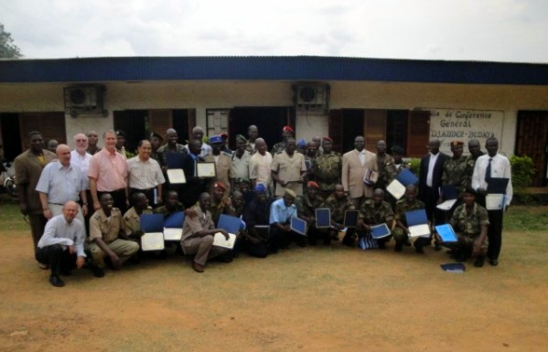
Contact Information
Email: iaecexecdir@gmail.com
Website: https//iaechap.org

Slide 19

Conclusion
Questions
or
Comments

Slide 20
Thank You and
Many Blessings!

